Slide 1
Raptor Message Daemon
How to create a message daemon in Raptor?

Slide 2
Covered in This Section
Raptor Message Daemon
Raptor and Messaging
Raptor's Kafka Integration
Sending messages
Receiving messages
Creating a Raptor message daemon in Altus
What's in the Archetype?
Developing message daemons
Spring Integration and Enterprise Integration Patterns
Overview of Enterprise Integration Patterns
PayPal and Messaging (YAM and AMQ)
Spring Integration

Slide 3
Introduction

Slide 4
PayPal and Messaging
Introduction
PayPal uses multiple messaging stacks
The two stacks supported by Raptor are:
YAM (Yet Another Messaging)
AMQ (Atlas Message Queue)
Kafka
YAM
Built on top of an ActiveMQ broker array
Bridges C++ and Java using customized serialization of VO (PayPal’s term for DTO’s)
AMQ
PayPal proprietary messaging solution
Uses Oracle (and OCC) to persist messages
Kafka
Open source high throughput publish-subscribe broker

Slide 5
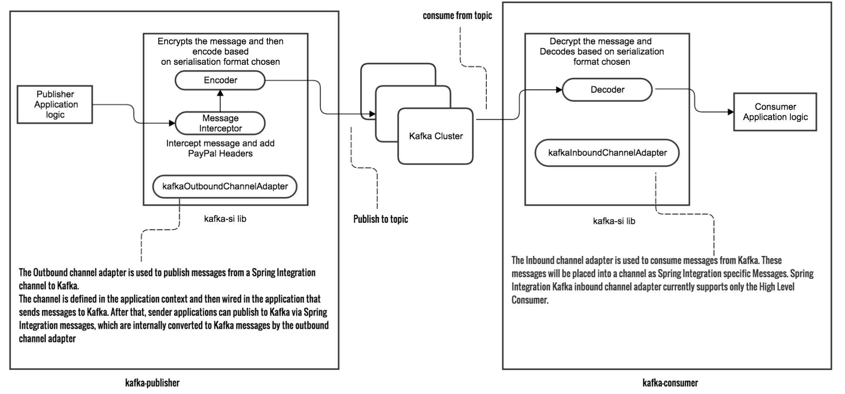
Kafka and Raptor Integration
Introduction

Slide 6
Kafka at PayPal
Introduction
Uses
Stream processing of real-time events
Buffer between online and offline systems (often for offline analysis)
Key Features
Reliable
High-throughput to handle large volumes of data and event data streams
Scalable to buffer data for long periods and support integration with batch systems
Durable
Fault Tolerant
Low Latency
Integrations Available to Stream Processing frameworks like Storm and Spark for real-time processing

Slide 7
Raptor and Message Daemon
Introduction
Raptor provides support for messaging
Sending messages from a Batch or Service
Creation of Message Daemons
The Message Daemon is a Spring Application
Started with Spring Boot
Based on Spring Integration
Support from Raptor
Access to PayPal services
Support for various PayPal specific API’s
Adapters for YAM and AMQ messages
Support for Kafka streaming
Altus template to create new applications (based on Maven Archetype)

Slide 8
Spring Integration and Enterprise Integration Patterns

Slide 9
Technology Foundation
Spring Integration and EIP
The Raptor integration with AMQ and YAM is based on Spring Integration
http://projects.spring.io/spring-integration/
To obtain fluency in Raptor Messaging, we strongly recommend that you learn the Spring Integration
We’ll cover the essentials in this course, however, there are much more to learn
What is the Spring Integration?
A programming model that supports the Enterprise Integration Patterns
See “Enterprise Integration Patterns: Design, Building and Deploying Messaging Solutions” by Gregor Hohpe and Bobby Woolf

Slide 10
Steps of Message Processing
Spring Integration and EIP
Create a Message
Deliver the Message
Receive the Message
Send the Message
Process the Message
Responsibility of the Producer
Responsibility of the Messaging System
Responsibility of the Consumer

Slide 11
What Is a Message?
Spring Integration and EIP
A Message is a generic wrapper for any Java object combined with metadata
Consists of:
Payload: A Java object to be delivered to some consumer
Header: Holds metadata such as timestamp, sender, receiver, etc.

Slide 12
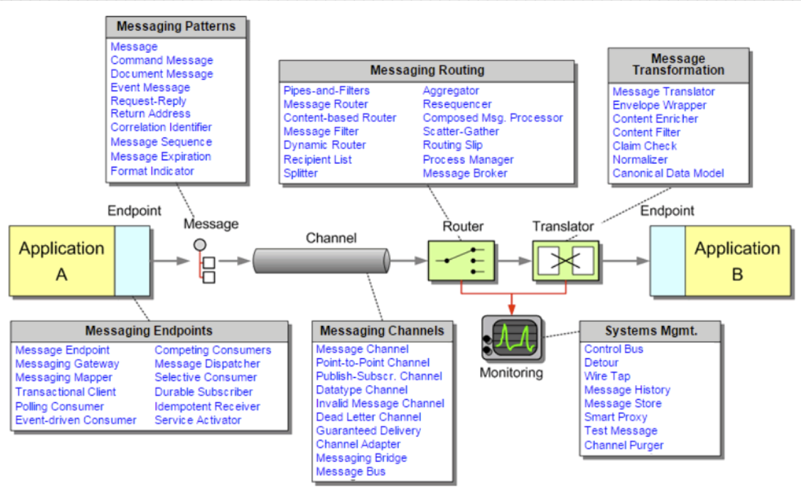
Spring Integration - Enterprise Integration Patterns
Spring Integration and EIP
Endpoint
Channel (Point-to-point and Publish-Subscribe)
Aggregator
Filter
Transformer
Control bus
Used with permission from Kiran Hegde

Slide 13
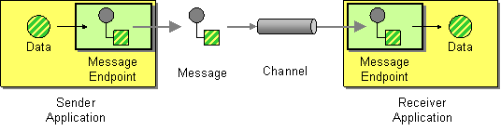
Key Terminology: (Message) Endpoint
Spring Integration and EIP
A client of the messaging system that can be used to send or receive messages
Your involvement
Implement your own endpoint that handles messages
Select and configure one of the configurable pre-defined (by Spring or the Raptor Framework) endpoints
Define chains of message handlers

Slide 14
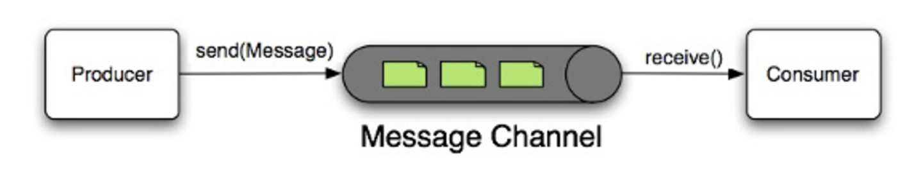
Key Terminology: (Message) Channel
Spring Integration and EIP
A message channel bridges a producer and a consumer of messages
Think of it as the pipe in a pipes-and-filters architecture
There are two kinds of channels
Point-to-point
One receiver
Publish-subscribe
Any number of receivers

Slide 15
Publish-Subscribe
Subscriber 1
Spring Integration and EIP
Publisher
Topic
Subscriber 2
…
Subscriber n
An N-N subscription model
Publishers produces messages on a topic
Subscribes subscribes to the topic
Any number of subscribers (including 0 (no) subscribers)
Message is delivered to all subscribers

Slide 16
Point-to-Point
Spring Integration and EIP
Sender
Queue
Consumer
Queue Owner
An N-1 queue model
A message is sent to a consumer
A sender sends a message to a specific consumer/receiver
You may have multiple consumers over the same queue, but only one of them receives the message

Slide 17
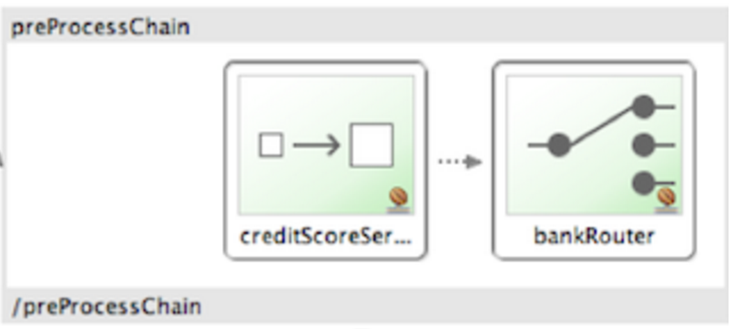
Key Terminology: (Message Handler) Chain
Spring Integration and EIP
A message hander implemented as a composite (composed as sequence)
One of the few implementation constructs that are not directly related to the Enterprise Integration Patterns
This can lead to a much simpler configuration when several handlers need to be connected in a fixed, linear progression

Slide 18
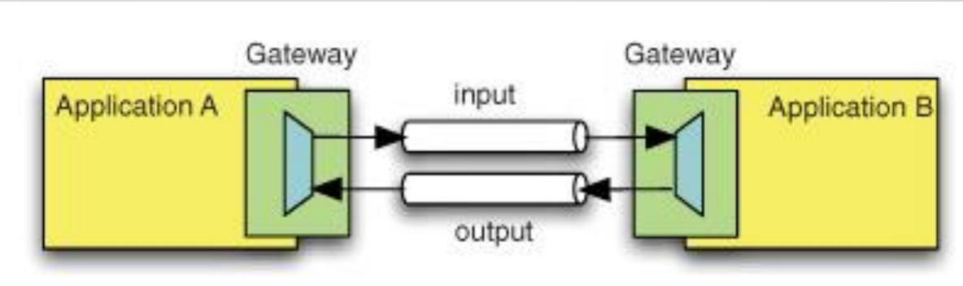
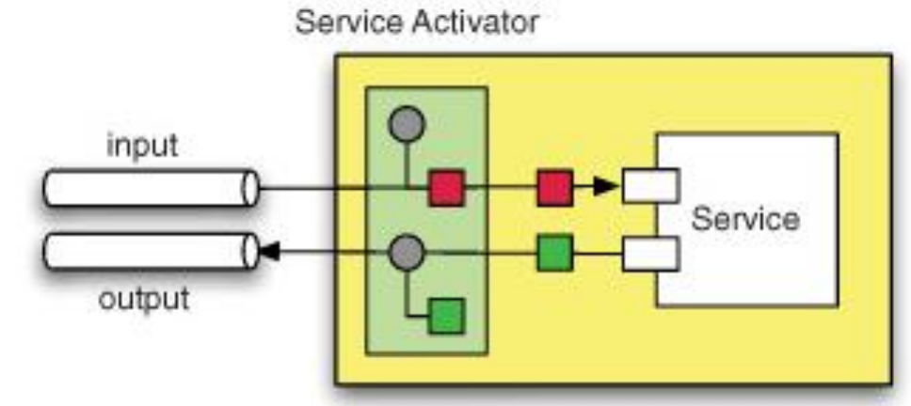
A Few Other Enterprise Integration Patterns (1/4)
Spring Integration and EIP
Messaging Gateway
Service Activator

Slide 19
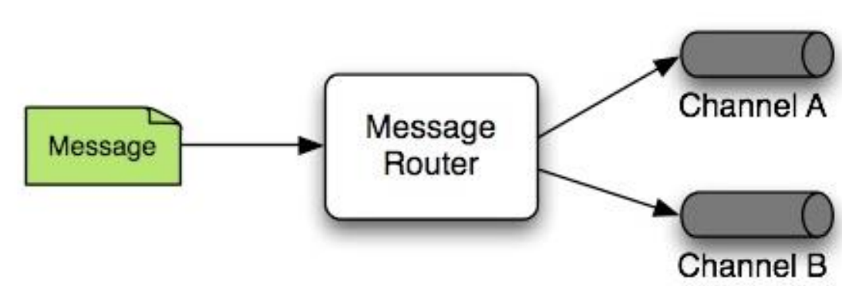
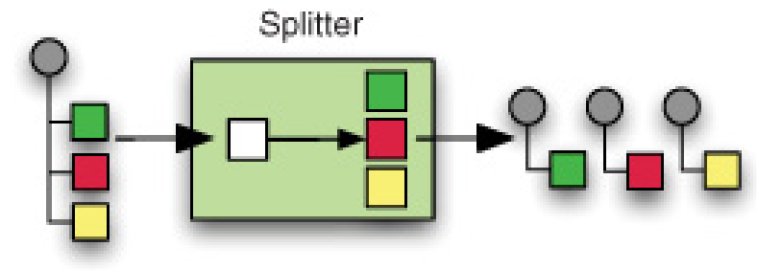
A Few Other Enterprise Integration Patterns (2/4)
Spring Integration and EIP
Router
Splitter

Slide 20
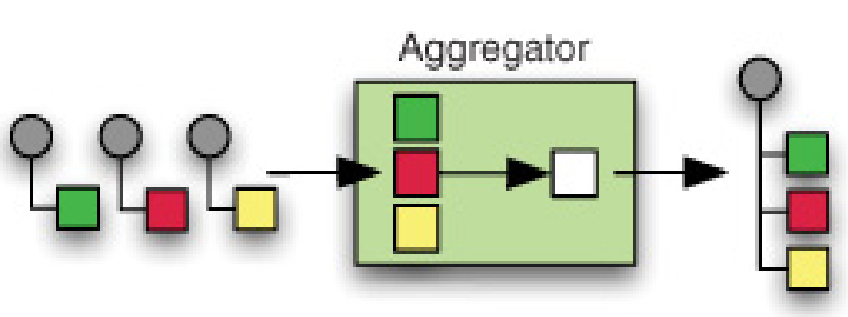
A Few Other Enterprise Integration Patterns (3/4)
Spring Integration and EIP
Aggregator
All of these (and many more) are supported by the Spring Integration
In addition to the implementation Spring also provides a DSL (Domain Specific Language) to orchestrate the patterns

Slide 21
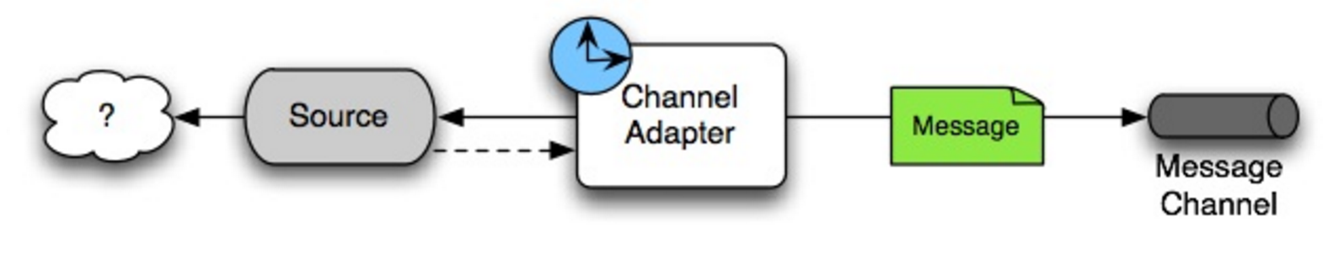
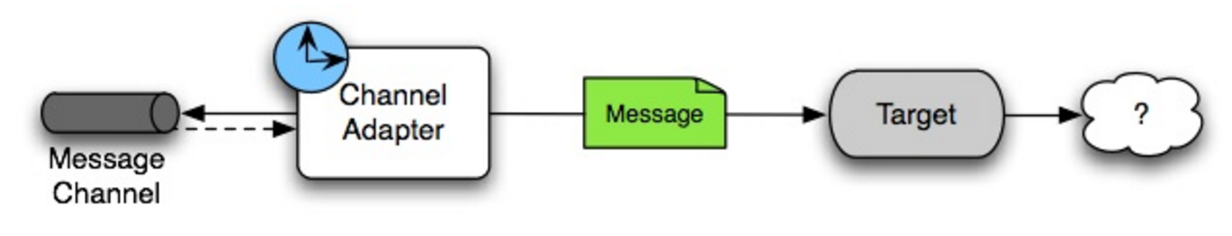
A Few Other Enterprise Integration Patterns (4/4)
Spring Integration and EIP
Inbound Channel Adapter
Outbound Channel Adapter
Channel Adapters are used to connect channels to external sources
Inbound connects an external producer
Outbound connects an external consumer
21

Slide 22
Orchestration
Spring Integration and EIP
The main idea:
Assuming we build a set of components that can perform the individual tasks described by the enterprise integration patterns
We can then build a orchestration engine that combines the primitives
Spring’s contribution:
A set of primitives based (and named) from the EIP book
A configuration language that allows you to specify how you combine the primitives
An ‘engine’ that can enforce the execution of primitives
Your role:
Build your own primitives
Define the processing steps using the configuration language

Slide 23
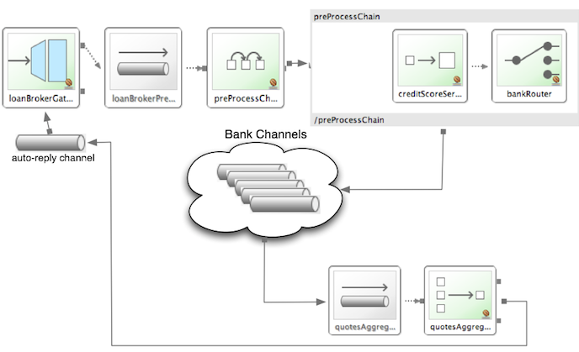
Orchestration Example: Loans
Spring Integration and EIP

Slide 24
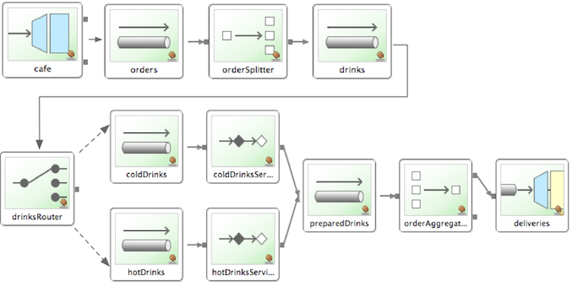
Orchestration Example: Café (Diagram)
Spring Integration and EIP

Slide 25
Orchestration Example: Café (XML)
Spring Integration and EIP
<?xml version="1.0" encoding="UTF-8"?>
<beans:beans ... >
<int:gateway id="cafe" service-interface="o.s.i.samples.cafe.Cafe"/>
<int:channel id="orders"/>
<int:splitter input-channel="orders" ref="orderSplitter" method="split" output-channel="drinks"/>
<int:channel id="drinks"/>
<int:router input-channel="drinks" ref="drinkRouter" method="resolveOrderItemChannel"/>
<int:channel id="coldDrinks"> <int:queue capacity="10"/> </int:channel>
<int:service-activator input-channel="coldDrinks" ref="barista" method="prepareColdDrink" output-channel="preparedDrinks"/>
<int:channel id="hotDrinks"><int:queue capacity="10"/></int:channel>
<int:service-activator input-channel="hotDrinks" ref="barista" method="prepareHotDrink" output-channel="preparedDrinks"/>
<int:channel id="preparedDrinks"/>
<int:aggregator input-channel="preparedDrinks" ref="waiter" method="prepareDelivery" output-channel="deliveries"/>
<int-stream:stdout-channel-adapter id="deliveries"/>
<beans:bean id="orderSplitter" class="org.springframework.integration.samples.cafe.xml.OrderSplitter"/>
<beans:bean id="drinkRouter" class="org.springframework.integration.samples.cafe.xml.DrinkRouter"/>
<beans:bean id="barista" class="o.s.i.samples.cafe.xml.Barista"/>
<beans:bean id="waiter" class="o.s.i.samples.cafe.xml.Waiter"/>
<int:poller id="poller" default="true" fixed-rate="1000"/>
</beans:beans>

Slide 26
Creating a Messaging Daemon

Slide 27
Two Choices
Create a Message Daemon
The proper way to cerate a Raptor project is always through Altus
Ensures the proper naming convention
Automatic provision of:
Infrastructure
Build jobs
Source code repository
Etc.
You may also create a message daemon using a Maven archetype
It is what Altus uses behind the scene
Only proper when playing around with ideas
Do not use this approach for applications to be shared and with the ultimate goal of going live

Slide 28
Create Message Daemon in Altus
Create a Message Daemon
We’ve already seen how to create a project in Altus
Two key differences when creating a message daemon
Pick the message daemon template
Select between AMQ, YAM or Kafka

Slide 29
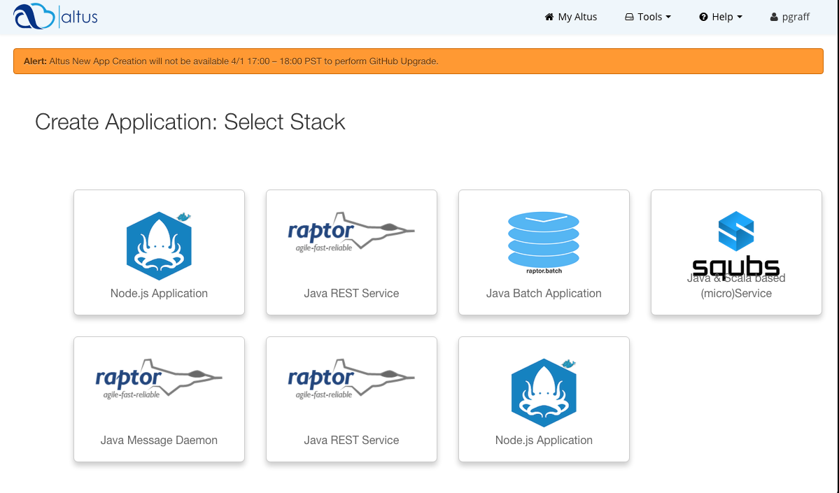
Select the Message Daemon Stack
Create a Message Daemon

Slide 30
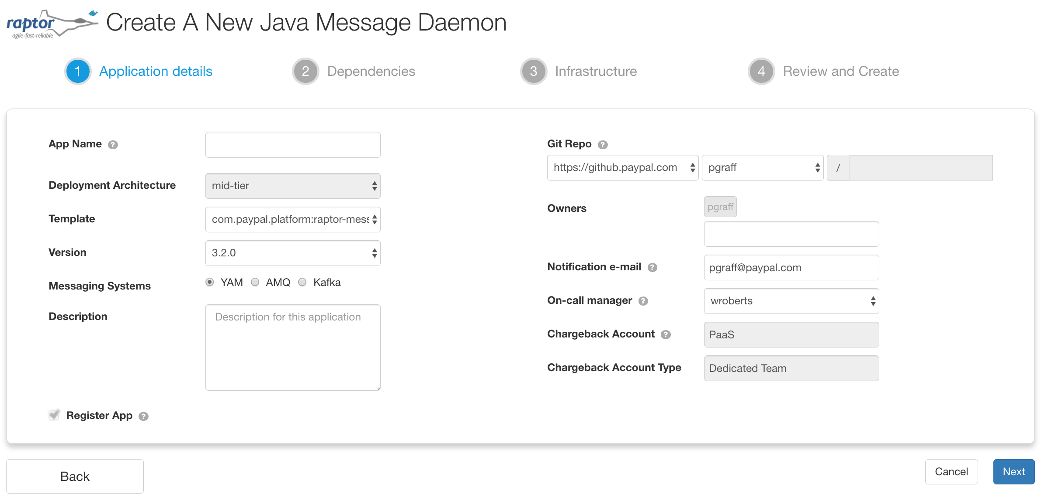
Select YAM or AMQ
Create a Message Daemon

Slide 31
When Using the Archetype
Create a Message Daemon
The Raptor Archetype for Message daemon requires two phase expansion
A maven archetype that creates the common file structures
A partial archetype that appends to the main archetype
The partial archetypes comes in three variants:
AMQ
YAM
Kafka
To create a message daemon using the archetype you have to
Run the base archetype
Run the partial archetype of you choice

Slide 32
Create Message Daemon Using Maven
Create a Message Daemon
mvn -U org.apache.maven.plugins:maven-archetype-plugin:RELEASE:generate \
-DarchetypeGroupId=com.paypal.platform \
-DarchetypeArtifactId=raptor-message-daemon \
-DarchetypeVersion=3.3.0
You’ll be prompted for various options
groupId
artifactId
version
package
AMQ vs YAM

Slide 33
Understand the Kafka Archetype

Slide 34
Initially Deactivated
Understand the Kafka starter project
The Kafka starter project is initially deactivated
All that is required to activate the archetype is to 'comment in' the integration file
The functional test requires JMX
One of the tests performed by the functional test requires that the Functional test connects using JMX to the message daemon
JMX is by default turned off
We must configure the VM running the daemon to allow for JMX connections

Slide 35
High Level Overview
Understand the Kafka starter project
Functional Test
Kafka
Message Daemon
1. Publish a message
2. Consume message
3. Verify # of messages using JMX

Slide 36
The Daemon
Understand the Kafka starter project
The daemon project is minimalistic
A simple service activator
All it does is to log that the message was received
An integration file that ties the pieces together
Defines an input adaptor for subscription to Kafka
Defines a channel that hooks up Kafka to the service activator
Sets up some logging and an error chann
JMX activation
The functional test requires JMX to verify that the message has been received by the daemon
We must enable JMX when running the message daemon

Slide 37
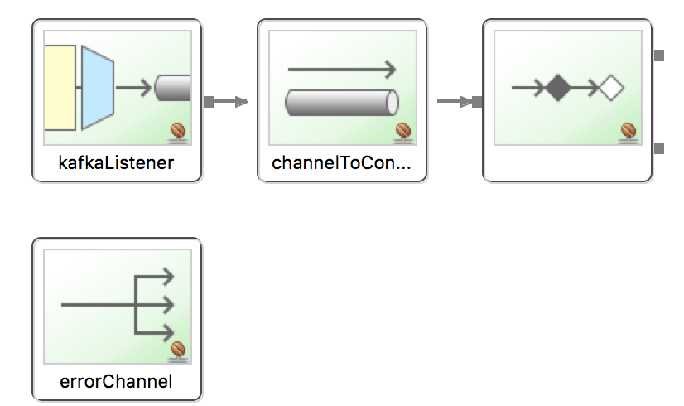
Overview of the integration.xml
Understand the Kafka starter project
<int-kafka:message-driven-channel-adapter
id="kafkaListener"
listener-container="container"
channel="channelToConsume"
error-channel="errorChannel"/>
<int:channel id="channelToConsume"> <int:interceptors> ... </>
</int:channel>
<int:service-activator
input-channel="channelToConsume" ref="kafkaSampleServiceActivator"/>

